Slide 1
Visual Programming(VP) Lec # 1 BCS Taimur Sajjad Lecturer. Dept of Computer Science, CUI, Wah Campus.

Slide 2
Course
Course title: Visual Programming
Instructor: Taimur Sajjad
Credit Hours: (2,1)
Course Code: CSC412
Semester: Sp 2024
Pre-requisite: Object Oriented Programming

Slide 3
Recommended Books
Reference Books:
Microsoft Visual C# 2013 Step by Step (Step by Step Developer), Sharp, J., 1st Edition (2013), Microsoft Press.
The Complete Reference C# 3.0, by Herbert Schildt, Latest Edition
Beginning C# Object-Oriented Programming (Expert’s Voice in .NET), Clark, D., 2nd Edition (2013), Apress Publisher.
MSDN (https://docs.microsoft.com/en-us/dotnet/)

Slide 4
Today’s Lecture
Overview of .Net framework

Slide 5
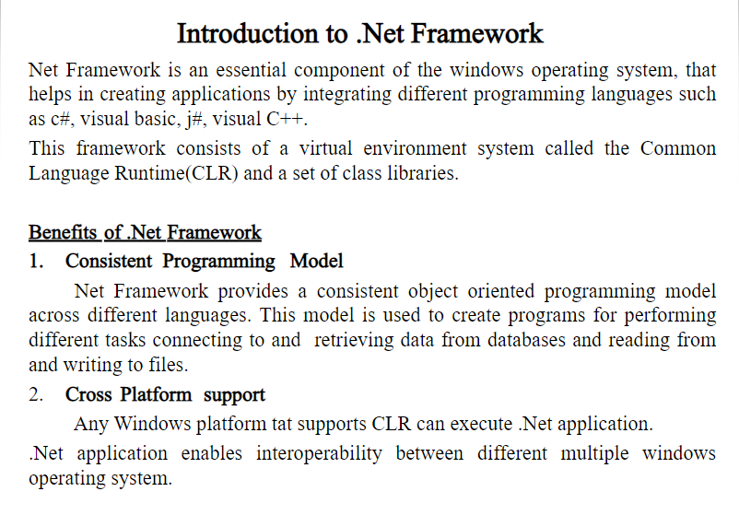

Slide 6
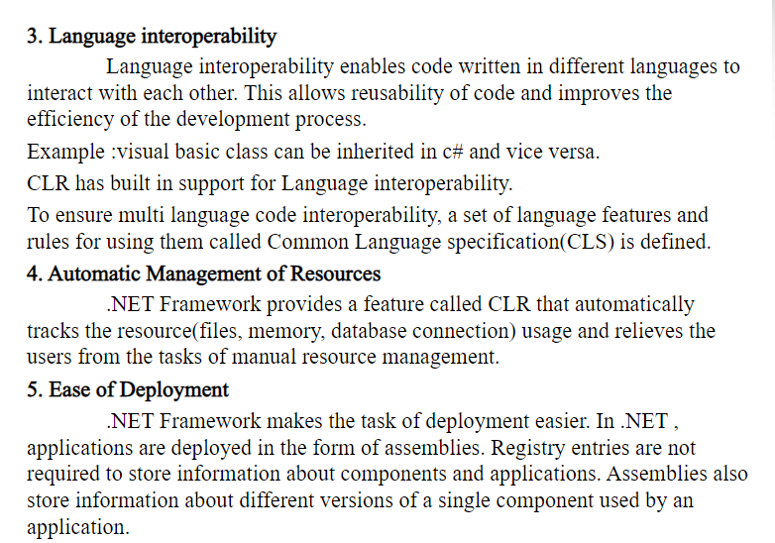

Slide 7
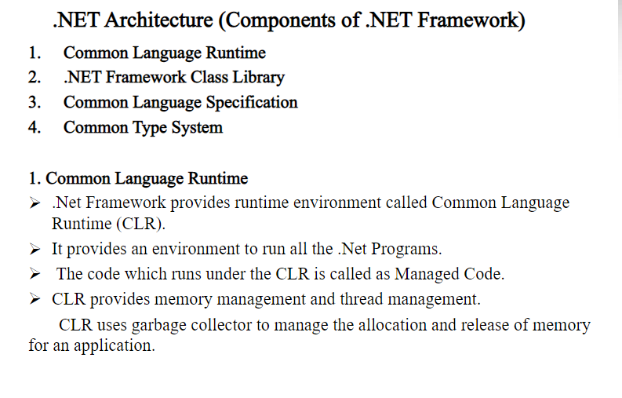

Slide 8
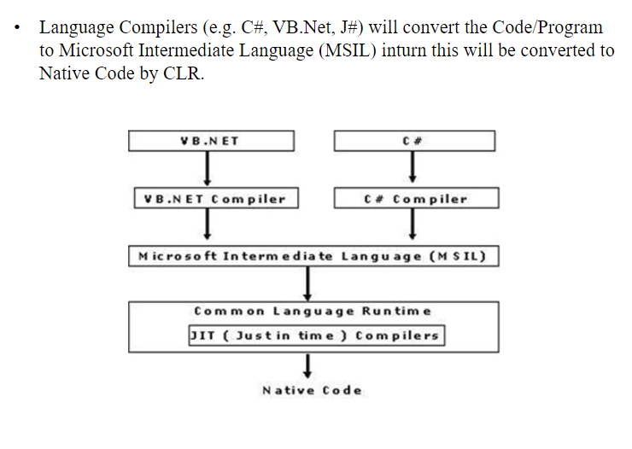

Slide 9
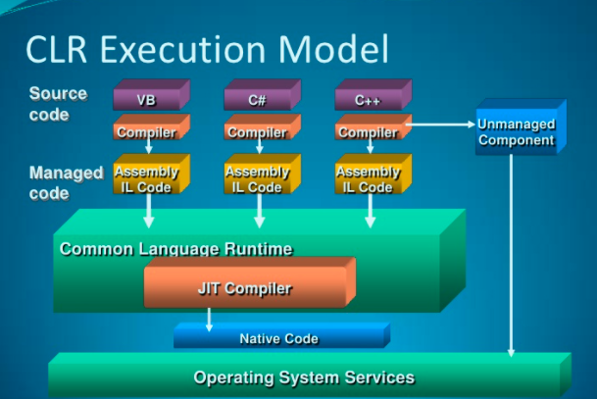

Slide 10
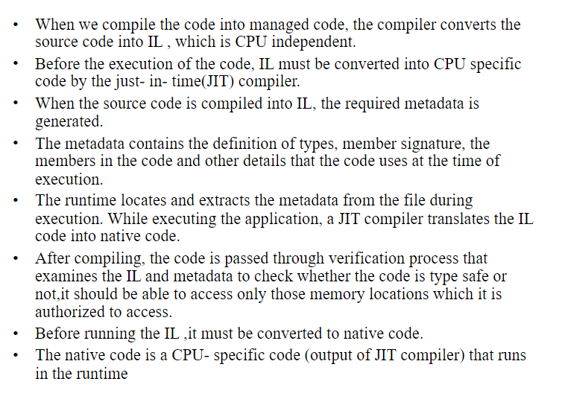

Slide 11
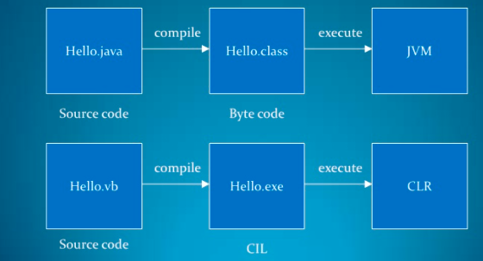
Comparison to Java

Slide 12
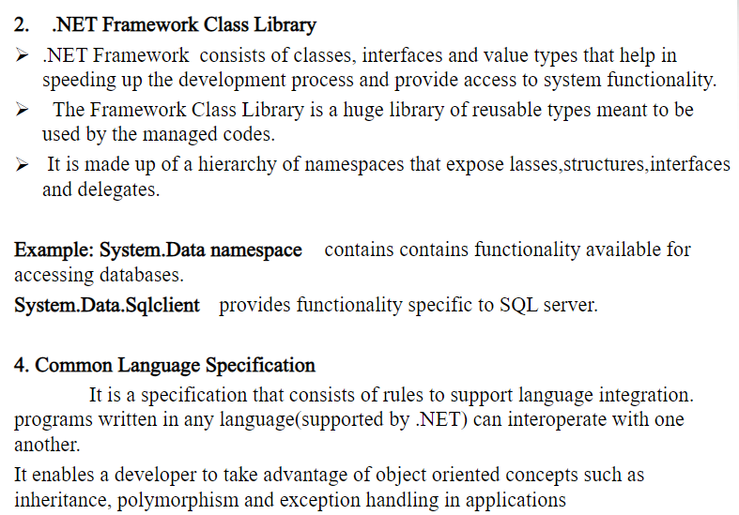

Slide 13
Common Language Specification (cont..)
CLS defines the base rules necessary for any language targeting common language infrastructure to interoperate with other CLS-compliant languages. For example, a method with parameter of "unsigned int" type in an object written in C# is not CLS-compliant, just as some languages, like VB.NET, do not support that type.
In C# every statement must have to end with a semicolon. it is also called a statement Terminator, but in VB.NET each statement should not end with a semicolon(;).
So these syntax rules which you have to follow from language to language differ but CLR can understand all the language Syntax because in .NET each language is converted into MSIL code after compilation and the MSIL code is language specification of CLR.
It forms a subset of the functionality of common type system (CTS)
CLS represents the guidelines to the compiler of a language, which targets the .NET Framework. CLS-compliant code is the code exposed and expressed in CLS form. Even though various .NET languages differ in their syntactic rules, their compilers generate the Common Intermediate Language instructions, which are executed by CLR.
Thus, CLS acts as a tool for integrating different languages into one umbrella in a seamless manner.

Slide 14
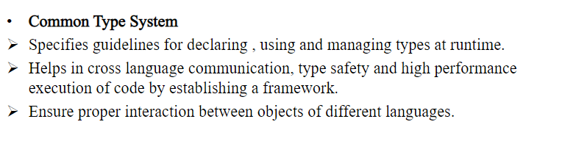

Slide 15
CTS (cont..)
CTS deals with the data type. So here we have several languages and each and every language has its own data type and one language data type cannot be understandable by other languages but .NET Framework language can understand all the data types.
C# has an int data type and VB.NET has Integer data type. Hence a variable declared as an int in C# and Integer in VB.NET, finally after compilation, uses the same structure Int32 from CTS.
All the structures and classes available in CTS are common for all .NET Languages and the purpose of these is to support language independence in .NET. Hence it is called CTS.

Slide 16
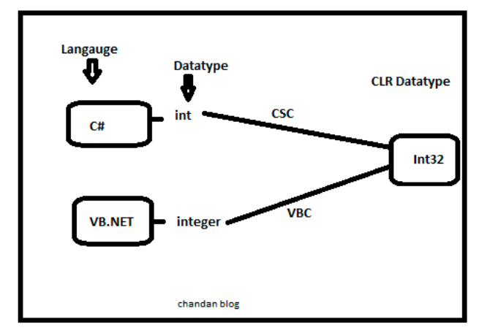
CTS (cont..)

Slide 17
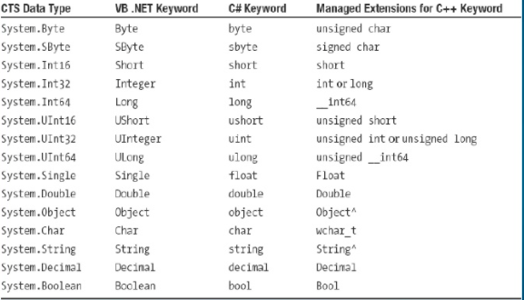
CTS Data Types

